Slide 1
Summer Statistics Workshop
Session 1: Basic Concepts
Sam Johnson
Mark Sheskin

Slide 2
This workshop might be right for you if…
…you don’t have much exposure to statistics.
…you need a refresher on basic concepts and tests.
…you want to learn the basics of different stats packages.
…you don’t have much experience with real data.
…you want to work on your scientific writing.
…you want to be a responsible producer of knowledge.

Slide 3
This workshop might be NOT right for you if…
…you are already a stats wizard.
…you want to learn fancy statistical techniques.
…you want to learn stats packages in depth.
…you are a pro with real data (or you dislike reality).
…you don’t want to do any writing.
…you aspire to be an unscrupulous scientist.

Slide 4
Topics
Today: Basic Concepts
June 21: Working with real data
June 28: T-tests
July 5: Analysis of variance (ANOVA)
July 12: Regression
July 19: Researcher degrees of freedom

Slide 5
Statistical tools
Excel
    Working with data
    Useful tricks
    T-tests
    Making bar plots and scatterplots
SPSS
    Two-way ANOVA
R
    Simple and multiple linear regression
G*Power

Slide 6
Today
Types of variables
Distributions
Confidence intervals and standard error
Hypothesis testing
Statistical risk management

Slide 7
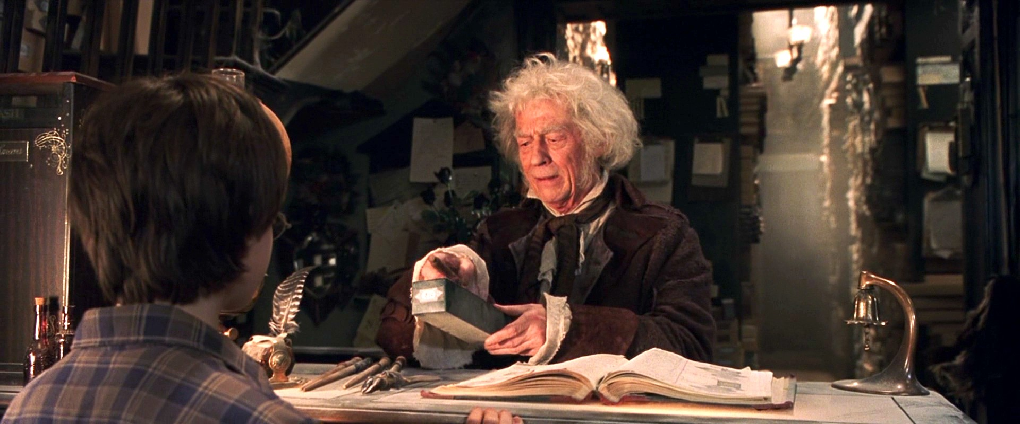
Mr Ollivander needs your help!
Research project on wand quality

Slide 8
Does the wand choose the wizard? Determinants of satisfaction in wand-wizard dyads.
Garrick K. Ollivander, Mark Sheskin, Samuel G. B. Johnson, and the Yale Summer Interns

Slide 9
What are some possible IVs?
Independent variable (IV): What we are manipulating (or taking as given/exogenous).
Examples:
  Wood type, wand core, wand length
  Years of magic experience, gender, country
  Affinity for dark arts, risk tolerance
  Spell being tested

Slide 10
What are some possible DVs?
Dependent variable (DV): What we are measuring (or taking as influenced/endogenous).
Examples:
  Wizard’s satisfaction, frequency of wand use
  Wizard preferences across wands
  Wand/wizard bonding scale
  Success or failure (dichotomous) at various spells

Slide 11
Continuous vs. discrete variables
Continuous:
  Can take a range of values
    Ordinal (ranks)
    Interval (temperature)
    Ratio (distance)
Discrete:
  Takes on only a small number of values (not necessarily ordered)
  If it’s an IV, discrete variables are called “factors” and the different values are called “levels.”
Notes:
Note: Go through examples students came up with (and from previous slide)

Slide 12
Which test?
Independent
Variable
Continuous
Discrete
Continuous
Correlation
Linear regression
t-test
ANOVA
Dependent
Variable
Discrete
Logistic regression
Chi squared
Notes:
Mainly for reference here (we’ll learn some of these tests later).

Slide 13
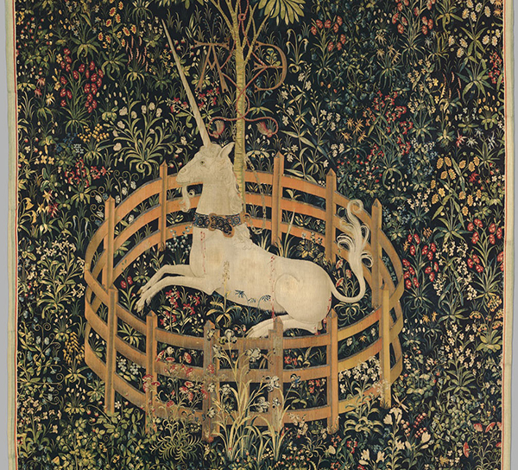
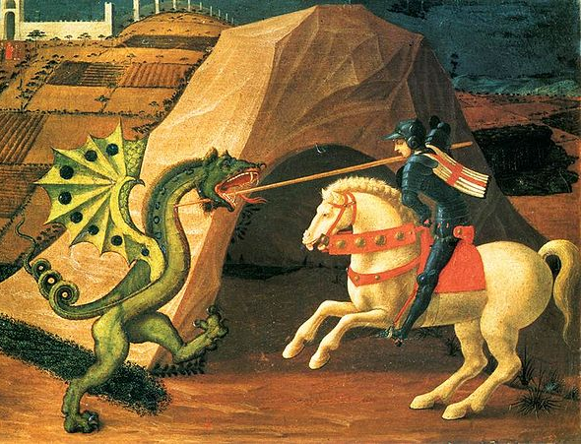
What makes for the best wand?
Notes:
Any ideas about how to test this?

Slide 14
Mr. Ollivander hypothesizes:
Unicorns evolved from non-magical ancestors more recently than dragons
Therefore, it stands to reason that dragons would have had more time to accumulate beneficial magical mutations
So, a wand made from dragon heart should be more powerful than a wand made from unicorn horn
Notes:
What’s the IV here? Material of wand (dragon vs. unicorn)

Slide 15
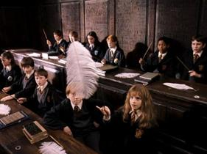
Wingardium leviosa!
T_{unicorn} = Feather levitation time with a unicorn wand
T_{dragon} = Feather levitation time with a dragon wand
Notes:
The DV: Number of seconds that a feather can be elevated

Slide 16

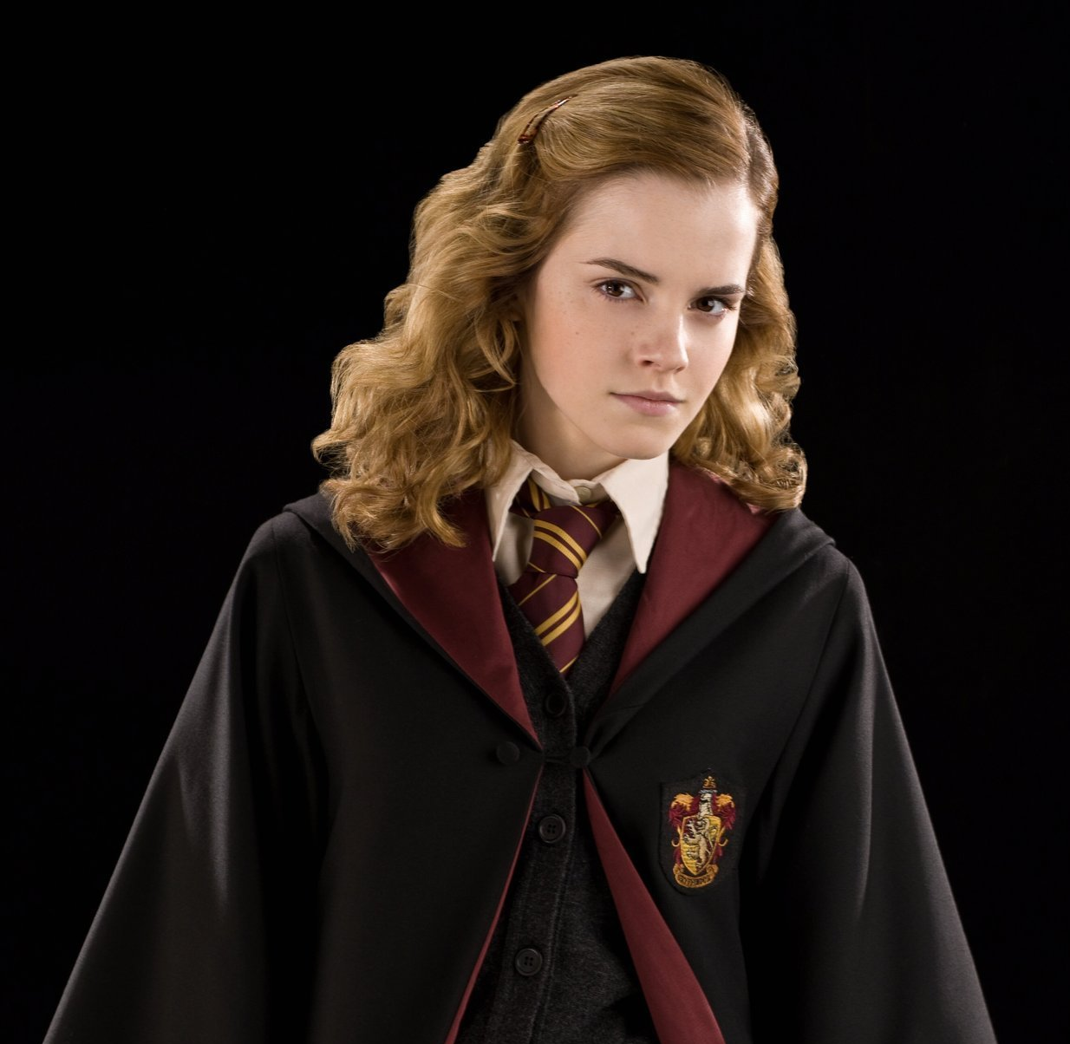
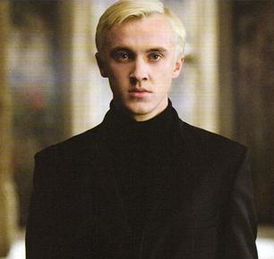
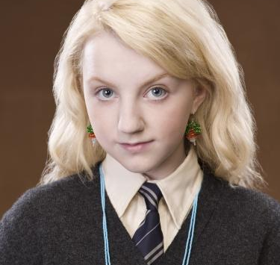
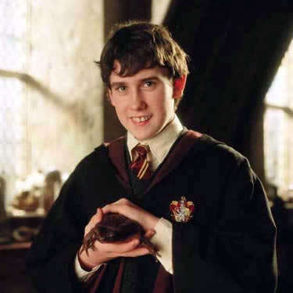
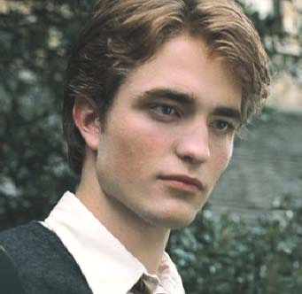
Levitation time with unicorn wand
8 seconds
9 seconds
7 seconds
7 seconds
5 seconds
8 seconds
Notes:
The between-subjects version

Slide 17
Distribution of a variable
5
7
9
Levitation time (in seconds)

Slide 18
Mean
The average score
Toward the middle of a distribution

Slide 19
M = (5 + 7 + 7 + 8 + 8 + 9) / 6
= 7.33
5
7
9
Levitation time (in seconds)

Slide 20
Standard Deviation
Tells you how “spread out” the scores are
Normally, most scores fall within 1 SD of the mean

Slide 21
SD = 1.37
5
7
9
Levitation time (in seconds)

Slide 22
Z Score
How many SDs an individual is from the mean
So, if z = -2 for Neville, then Neville is 2 SDs below the mean

Slide 23
M = 7.33
SD = 1.37
score = 9 sec.
z = ???
= 1.67/1.37 = 1.25
5
7
9
Levitation time (in seconds)

Slide 24
So, what fraction of people can levitate feathers longer than Neville?
z = -2
68%
95%
5
7
9
Levitation time (in seconds)

Slide 25
Experiments
Usually, when we do experiments, we’re not interested in individuals
Instead, we’re interested in the differences between different groups or conditions
The way we look for these differences is by estimating what the population mean (μ) is for each condition

Slide 26
Between-subjects experiment
Within-subjects experiment
IV is manipulated so that each person is in every condition
IV is manipulated so that different people are in different conditions
Notes:
What’s the IV here? Material of wand (dragon vs. unicorn)

Slide 27
Unicorn Group
Dragon Group
8 seconds
13 seconds
7 seconds
8 seconds
5 seconds
9 seconds
Notes:
The between-subjects version

Slide 28
Unicorn
Condition
Dragon
Condition
Difference
8 seconds
10 seconds
+2 seconds
7 seconds
6 seconds
-1 second
5 seconds
6 seconds
+1 second
Notes:
The between-subjects version

Slide 29
Randomness is your friend
What if some people happen to better at levitating feathers than others?
  Random assignment to experimental condition: Allows causal claims.
What if part of the population is different from other parts?
  Random sampling from target population: Allows generalization from sample to population.

Slide 30
Populations and samples
Goal is to estimate population mean (μ) in each condition.
We almost never know the true population mean (if we did, we wouldn’t need to do an experiment!)
Instead, we use samples to guess what are likely values of the population mean.
Figuring out what guesses are plausible and which are not plausible is the fundamental problem of statistics.

Slide 31
The sampling distribution
Study 5
These aren’t individuals, these are means of samples!
Study 4
Study 11
Study 3
Study 8
Study 10
Study 2
Study 7
Study 15
Study 14
Study 9
Study 1
Study 6
Study 12
Study 13
μ
Levitation time (in seconds)

Slide 32
Standard error
The standard deviation of the sampling distribution is called the standard error (SE)
In other words, if we repeated our experiment over and over again, how much would the results vary?
We can estimate SE from just one sample!
For our study, SE = 1.37/sqrt(6) = 0.5

Slide 33
Study 5
95% of studies have means within 1 second (either way) of the true mean
Study 4
Study 11
Study 3
Study 8
Study 10
Study 2
Study 7
Study 15
Study 14
Study 9
Study 1
Study 6
Study 12
Study 13
μ
μ - 1
μ - .5
μ + .5
μ + 1
Levitation time (in seconds)

Slide 34
Testing Ollivander’s hypothesis
Suppose Ollivander commissioned a survey of all the wizards in the land, and he knows that T_{dragon} is exactly 6 seconds on average in the population
Now, Ollivander just wants to know whether T_{unicorn} is different from 6 seconds

Slide 35
Null hypothesis significance testing
Answers the question: If we were wrong (i.e., there is no difference), how likely would our results be?
If not very likely, then there probably is a difference.
So, how likely would our study results be if the true population mean were 6?

Slide 36
So, if the mean were really 6, what’s the z-score of our study?
(*By the way, this is what a t statistic is!)
M = 7.33
SE = 0.50
Study 5
Study 4
Study 11
Study 3
Study 8
Study 10
Study 2
Study 7
Study 15
Study 14
Study 9
Study 1
Study 6
Study 12
Study 13
6
6 - 1
6 - .5
6 + .5
6 + 1
Levitation time (in seconds)

Slide 37
So, 6 isn’t a very likely value of the population mean for T_{unicorn}, since fewer than 5% of studies would have a sample mean of 7.33
But what are the plausible values of the population mean for T_{unicorn}?

Slide 38
95% confidence intervals
If we repeated our study many times and the population mean equaled our sample mean, then about 95% of the repetitions would fall within the 95% confidence interval (CI).
Guesses for the population mean are considered plausible if they fall within the 95% CI.
M ± 2 SE

Slide 39
What happens if we increase the sample size from 6 to 24?
95% CI
Plausible values of population mean
7.33
6.33
6.83
7.83
8.33
Levitation time (in seconds)

Slide 40
What happens if we increase the sample size from 6 to 24?
95% CI
Plausible values of population mean
7.33
6.33
6.83
7.83
8.33
Levitation time (in seconds)

Slide 41
Testing Ollivander’s hypothesis
Null hypothesis (H₀): True if there is no difference between groups
    T_{unicorn} = T_{dragon}
Alternative hypothesis: True if there is a difference between groups
    T_{unicorn} ≠ T_{dragon}
So, if Ollivander is right, we should reject H₀

Slide 42
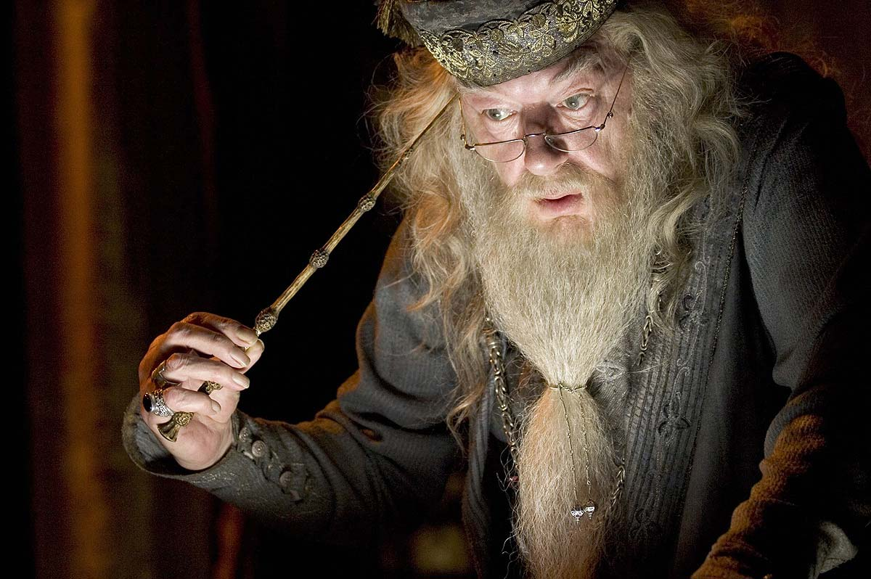
Science is risk-taking!
And statistics is risk management.
“Curiosity is not a sin.... But we should exercise caution with our curiosity... yes, indeed.”

Slide 43
Types of Risk
Conclusion of test
“Yes, there’s a difference”
(Reject H₀)
“No, there’s no difference”
(Accept H₀)
There really is a difference!
You discovered something!
TYPE II ERROR
Reality
You were wrong…but at least you didn’t publish something false!
Really, it makes no difference
TYPE I ERROR

Slide 44
Unicorn
Condition
Dragon
Condition
Difference
8 seconds
10 seconds
+2 seconds
7 seconds
6 seconds
-1 second
5 seconds
6 seconds
+1 second
Notes:
The within-subjects version

Slide 45
Suppose we run this experiment with 100 subjects
The mean difference is +1.0
  That is, levitation times are 1 second more with the dragon wands
Is this a reliable difference?
Is this a big difference?
Significance level!
Effect size!

Slide 46
Imagine there were no difference
How plausible would our results be under the null hypothesis?
95% CI
Plausible values of population mean
-2 SE
-1 SE
0
+1 SE
+2 SE
Difference in levitation time (sec.)

Slide 47
What do we need to calculate the z score for this sample?
N = 100
M = +1.0
SD = 10.0
A lot of samples are this extreme or more. So if we were willing to adopt a criterion this loose, we would make Type I errors about 32% of the time when there is no effect
This is what p = .32 means
SE = 10.0 / sqrt(100) = 1.0
z = (M – 0)/SE = +1.0/1.0
= +1
95% CI
Plausible values of population mean
-2.0
-1.0
0
+1.0
+2.0
Difference in levitation time (sec.)

Slide 48
Controlling Type I risk
The scientific community has decided that we are willing to tolerate Type I errors 5% of the time when there really is no effect
  In other words, α = .05
We therefore adopt a rule to reject the null hypothesis when p < .05
In our wand study, we do not reject the null hypothesis, and conclude that there is no evidence for Ollivander’s hypothesis

Slide 49
So, how big would the difference need to be to conclude that there’s a real difference?
If there were no difference, 2.5% of samples of this size would have differences of +2 or more by chance, and 2.5% would have differences of -2 or more by chance
  So, to reject H_{O} at
  α = .05, the difference needs to be at least 2 seconds
95% CI
Plausible values of population mean
-2.0
-1.0
0
+1.0
+2.0
Difference in levitation time (sec.)

Slide 50
But could this be a Type II error?
Calculating the likelihood that our procedure makes Type II errors is called power analysis
Power = (1 – Type II error rate)
A study must have high power to be informative (usually, 80% or 90% is considered adequate).

Slide 51
Effect size
The size of the difference between conditions
  In our example, the effect size would be +1 seconds
Power is defined relative to a particular effect size
The Type I error rate is the likelihood of declaring a difference significant when the effect size is 0
Power is the likelihood of declaring a difference significant when the effect size is some number greater than 0

Slide 52
Let’s suppose there is a real difference between groups (i.e., between the population means), and it’s 1 second
What was the likelihood of observing a significant difference given our SD = 10.0 and N = 100?

Slide 53
Imagine there was a difference of 1 sec.
How likely would it be for us to reject the null hypothesis?
95% CI
Plausible values of population mean
-2 SE
-1 SE
1
+1 SE
+2 SE
Difference in levitation time (sec.)

Slide 54
Imagine there was a difference of 1 sec.
How likely would it be for us to reject the null hypothesis?
We said before that we would reject H_{O} if the difference was +2 seconds or more
16% of samples would have a difference of at least this size, so our power is 16%
Plausible values of population mean
-1
0
1
+2
+3
Difference in levitation time (sec.)

Slide 55
Tips for maintaining adequate power
Think of how big you think the effect might be, and pick a sample size that will be informative
Minimize the variability as much as you can

Slide 56
Next time
Using Excel to explore data
Excel tips and tricks
Basic graphing (bar plots, scatter plots)

Slide 57
Before next time
Exercise 1
  Exercises are optional but strongly encouraged
  Thinking about designs for simple ”factorial” experiments
  Writing (very brief!) methods sections
  If you want feedback, please email to both of us (sgbjohnson@gmail.com and msheskin@gmail.com) before the start of Session 2

